Slide 1
MODULE 5
Problem of Concurrency Control – Serializability – Basic Synchronization Primitives for Concurrency Control – Lock-Based Algorithms – Time- Stamp Based Algorithms – Optimistic Algorithms.

Slide 2
DataBase Systems
A database system consists of a set of shared data objects(file, page record etc),which can be accessed by the users.
The state of a database is given by the values of its data objects.
The read and write actions performed by the users on data objects are grouped together as a single unit of interaction- transaction.
Transactions conflict if they operate on same data object and at least one of them is a write action(w-w conflict, r-w conflict, w-r conflict).
A Transaction is executed by executing its actions one by one from the beginning to end.

Slide 3
Concurrency Control Model of DB system
A DB system consists of 3 s/w modules:
Transaction Manager (TM)
Data Manager (DM)
Scheduler.
Transaction manager assigns a time stamp to transaction and issues a request to lock and unlock data object for user.
DM: manages the DB and carries out read-write requests issued by TM .
Scheduler: Enforces the concurrency control by granting or releasing locks on data objects

Slide 4
The Problem of Concurrency Control
To ensure the consistency ,the transactions are executed serially one at a time.
But this approach results in poor response and poor utilization of resources.
Efficiency is improved by executing transactions concurrently, where read and write actions from different transactions are executed in an interleaved manner.
The interleaved execution of actions should performed in an orderly way to avoid several anomalous situations.

Slide 5
The Problem of Concurrency Control
Inconsistent Retrieval
Occurs when a transaction reads certain data objects before another transaction has completed its modification.
Former transaction faces the risk of retrieving incorrect values of the data objects.
Inconsistent update
Occurs when many transactions read and write onto a common set of data objects of a database, leaving in an inconsistent state.
Concurrency control problem
If the interleaving of actions of transactions is not controlled ,some transactions may see an inconsistent state of the database and db may be left in an inconsistent state

Slide 6
The Problem of Concurrency Control
In db, concurrency control problem is handled by controlling the relative order of the conflicting actions.
This ensures that every transaction sees a consistent state of db and when all transactions are over the db is still in a consistent state.
While using concurrency control mechanism to ensure consistency, the question is ,to what degree the concurrency must be controlled

Slide 7
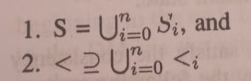
Serializability Theory
Theory of serializability gives precise rules and conditions under which a concurrent execution of a set of transactions is correct.
It makes use of a history variable called log to model the execution of concurrency control algorithm
Log captures the chronological order in which the read and write actions of a transaction are executed.
Le T={T0,T1,…Tn} be a transaction system.
A log over T models an interleaved execution of T0,T1…Tn and is a partial order set L=(S,<) where;
Si –set of read and write actions
<i-order in which these actions are executed

Slide 8
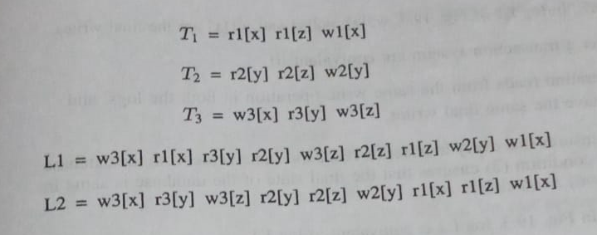
Serializability Theory
Condition 1 states that db executes all actions submitted only by T0,T1….Tn.
Condition 2 states that db executes actions in order expected by each transaction
Eg:

Slide 9
Serial Logs
If transactions in a DB are executed strictly serially, then the resulting log is called serial log.
Serial log represents execution of transactions, where actions from different transactions are not interleaved.
For a set of transactions T0,T1,…Tn, serial log is of form Ti1,Ti2,….Tin where i1,i2….in is a permutation of 1,2…n.
Since each transaction individually maintains db consistency ,it follows that a serial log maintains DB consistency

Slide 10
Serial Logs
Log 2 is a example of serial log because actions from different transactions are not interleaved

Slide 11
Log Equivalence
Two logs are equivalent, if all transactions in both logs see the same state of database and leave the DB in same state after all transactions are finished.
Let l be a log over transaction system T={T0,T1,…Tn}and on a Db system D=(x,y,z…).
If wi[x] and rj[x] are 2 operations in L, then we say that rj[x] reads from wi[x] iff,
1.wi[x]<rj[x]
2. there is no wk[x] such that wi[x]<wk[x]<rj[x]
We call wi[x] a final write, if there is no wk[x] such that wi[x]<wk[x]

Slide 12
Log Equivalence
Two logs over a transaction system are equivalent iff:
Every read operation reads from the same write operation in both the logs ,and
Both logs have same final write values.

Slide 13
Serializable Logs
Even though serial logs ensure that database terminates in a consistent state after the termination of transactions, it results in poor performance.
Serializable log was introduced to improve the performance of serial logs.
Serializable log is obtained by interleaving of actions of transactions T1,T2,….Tn and
It produces the same output and has the same effect on the database as the serial execution of a permutation of T1,T2,…..
A serializable log is equivalent to serial log and represents a correct execution

Slide 14
Serializability Theorem
What are the conditions that should be satisfied by interleaved execution to be serializable.
The serializability Theorem states these conditions for serializability using a serialization graph , which is constructed from the log.
Let L be the log over a set of Transactions {T0,T1,…Tn}
The serialization graph S(G) is a directed graph whose nodes are T0,T1,…Tn and with edges that satisfies the following condition:
There is an edge from Ti to Tj ,if for some shared object x,
Either ri[x]<wj[x] or wi[x]<rj[x] or wi[x]<wj[x]

Slide 15
Serializability Theorem
A log L is serializable iff SG(L) is acyclic
Given an acyclic graph SG(L) we can find a serial log corresponding to log L by topologically sorting Sg(L)

Slide 16
Basic Synchronization Primitives for Concurrency Control
LOCK BASED ALGORITHMS

Slide 17
Introduction
Concurrency control algorithm controls interleaving of conflicting actions of transactions so that integrity of DB is maintained.
There are 2 basic synchronization primitives used by these algorithms
Locks
Time stamps

Slide 18
Basic Synchronization Primitives
Locks:
Each data object has a lock associated with it
A transaction can request, hold or release the lock on a data object.
A transaction can lock a data object in two modes: exclusive and shared.
When transaction locks an object in exclusive mode, no other transaction can concurrently lock it in any mode.
If a transaction has locked a data object in shared mode, other transactions can concurrently lock it, but only in shared mode.
The lock ensures that locked object while temporarily in inconsistent states are in accessible to other transactions.

Slide 19
Basic Synchronization Primitives
Timestamps:
A unique number that is assigned to an transaction or data object.
Commonly generated according to Lamport’s Scheme.
Every Site Si has a logical clock Ci, which takes monotonically increasing values.
When a transaction T is submitted at site Si, Si increments Ci by one and then assigns a 2-tuple (Ci, i) to T, referred to as the timestamp of T.

Slide 20
Basic Synchronization Primitives
Timestamps:
The timestamps have 2 properties:
Uniqueness: timestamps generated by diff sites differ in side id part and time stamps generated by same site differ in clock value part.
Monotonicity: site generates timestamps in increasing order
Provides a way to order transactions of a distributed system by simply ordering transactions by their timestamps

Slide 21
Lock Based Algorithms
These algorithms adopt a strategy where transactions lock a data object before accessing it.
A transaction T is a sequence of actions {a19d10,a2(d2),….an(dn)},where ai is the operation performed in ith action di is the data object acted upon in ith action.
In addition to read and write, lock and unlock are also actions permitted in lock based algorithms.
A transaction is well informed if it is:
Locks a data object before accessing it
Doesn’t lock data object more than once
Unlocks all locked data objects before it completes

Slide 22
Lock Based Algorithms-Static Locking
A transaction acquires locks on all data objects it needs before executing any action on data objects.
This approach requires a transaction to pre-declare all data objects it needs for execution.
Transaction unlocks all locked data objects only after it has executed all of its actions.
This approach limits concurrency because any 2 transactions that have a conflict must execute serially, limiting the performance of underlying db.

Slide 23
Two-Phase Locking(2PL)
Dynamic locking scheme in which the transaction requests a lock on a data object when it needs the data object.
2PL imposes a constraint on lock acquisition and lock release actions of a transaction to guarantee consistency.
A transaction cannot request a lock on a data object after it has unlocked a data object.
So the transaction must acquire locks on all needed data objects before unlocking an object.
There are 2 phases in the algorithm:
Growing Phase
Shrinking phase

Slide 24
Two-Phase Locking(2PL)
Growing Phase: Transaction Requests locks
Shrinking Phase: Transaction releases the locks
The stage of transaction when the transaction holds locks on all needed data objects is referred to as lock point.
Two phase locking increases concurrency over static locking, as locks are held for a shorter period.

Slide 25
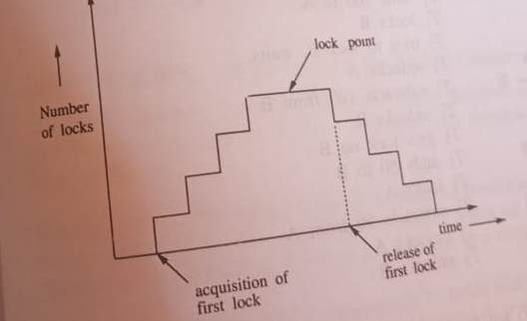
Two-Phase Locking(2PL)

Slide 26
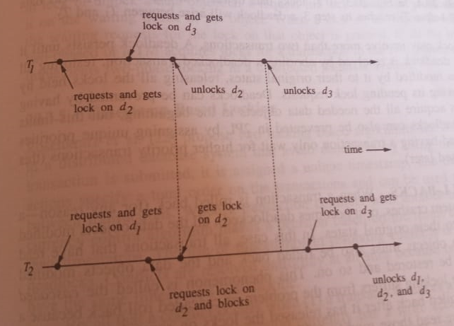
Two-Phase Locking(2PL)
When a set of transactions are well informed and follow 2 Phase Lock, then all legal logs are serializable.
Suppose 2 transactions T1 and T2 have following read and write sets.
RS(T1)={d2,d3} and WS(T1)={d3}’
RS(T2)={d1,d2,d3},WS(T20={d1,d2,d3}

Slide 27
Problems with 2PL
2PL suffers from problems of deadlock and cascade aborts.
Deadlocks
In 2PL,a transaction requests a lock on a data object while holding locks on other data objects.
A set of transactions are deadlocked, if they are involved in a circular wait.
Dead locks can be prevented by having each transaction acquire all needed data objects in the beginning, but limits concurrency.
Deadlocks can also be prevented by assigning unique priorities to transactions and having a transaction only wait for higher priority transactions.

Slide 28
Problems with 2PL
Cascade Rollbacks
When a transaction is rolled back ,all data objects modified by it are restored to their original states.
Also all transactions that have read the backed up data objects must be rolled back and the data objects modified by them should also be restored and so on.
2Pl suffers fro cascading rollback because a transaction may be rolled back after it has released the locks on some data objects and other transactions must have modified it.
Solution : Strict 2PL
A transaction holds all its locks until it completes and releases all its lock in one atomic action, often called commit.

Slide 29
2PL in Distributed Data Base Systems.
2PL can be implemented in DDB in the following way:
A DM at a site controls the locks associated with objects stored at that site.
A TM communicates with appropriate DM to lock or unlock data object.
If the requested object is already locked, then request is put on a waiting queue of object.
When a lock is removed from the object, one of the waiting requests is processed.
2PL can be implemented in DDB ,if transactions are 2 phased or a TM acquires locks for a transaction in two-phased manner

Slide 30
Timestamp-Based Locking
Dead locks in DDB can be avoided by using time stamps in lock based algorithms.
When a transaction is submitted, it is assigned a unique timestamp.
The timestamp specifies a total order on transactions can resolve conflicts b/w transactions.
Two algorithms are proposed:
Wait and Die Algorithm
Wound and Wait Algorithm

Slide 31
Wait and Die Algorithm
A non pre-emptive algorithm as the requesting transaction never forces transaction holding the request data object to abort.
A requesting transaction T1 is in conflict with a transaction T2.
It can be W-W Conflict, R-W Conflict or W-R conflict.
If T1 is older (ie has a smaller timestamp),then T1 is made to wait until T2 either completes or aborts.
If T1 has a larger timestamp, then T1 dies,ie,T1 aborts and starts afresh.

Slide 32
Wound & Wait Algorithm
A pre-emptive algorithm
A requesting transaction T1 is in conflict with a transaction T2.
If T1 is older, it wounds.
Ie, the transaction T2 in conflict with T1 is tagged as wounded and a msg wounded is sent to all sites that the wounded transaction has visited.
If the message is received before the wounded transaction(T2) has committed at a site, an abort of T2 is initiated, otherwise msg ignored.
The requesting transaction(T1) proceeds after the wounded transaction completes or aborts.
Otherwise, if T1 has larger Timestamp T1 waits until T2 either completes or aborts

Slide 33
Comparison
Waiting time
In WAIT-DIE an older transaction is made to wait for younger ones.
So, older the transaction becomes, higher the no: of younger transactions it waits for and tends to slow down
In WOUND-WAIT older transaction never waits fro younger transactions.
It wounds all younger transactions that conflicts with it.
So, the less it tends to slow down.

Slide 34
Comparison
No: of restarts
In WAIT-DIE, Younger request dies and it restarts.
If the younger request restarts with same timestamp, conflicts may arise again with older transaction and again die.
So a younger transaction may die and restart several times before it completed.
In WOUND-WAIT if the requester is younger, it waits rather than dying continuously

Slide 35
Non-Two Phase Locking
A non 2 phase locking ensures serializability and freedom from deadlock, when data objects are hierarchically organized
Here a transaction can request a lock on a data object even after releasing locks on some data objects.
But a data object cannot be locked more than once by same transaction
A transaction first locks data objects inorder to get access to it.
A transaction trying to lock already locked object gets blocked.
When a transaction unlocks an object, one of the waiting transactions gets lock and resumes

Slide 36
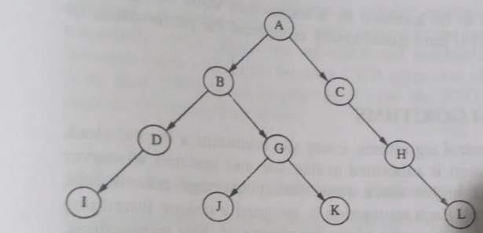
Non-Two Phase Locking
When a transaction Ti starts it locks a data object E(Ti) in the Data base tree and can subsequently lock data objects only in the sub tree with root node E(Ti) .
Also a transaction can only lock an object, only if its immediate ancestor also is currently locked by it.

Slide 37
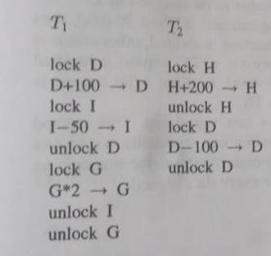
The locking Protocol
1. Ti can lock data object R≠E(Ti) iff Ti is holding a lock on R’s ancestor.
2. After unlocking a data object Ti cannot loc it again.
3. Ti can only access those data objects for which it is holding a lock
Serializability is achieved as data objects are locked in ascending order
Here deadlocks are avoided because tree structure puts an order on data objects and first rule of protocols guarantees that data objects are requested in ascending order.

Slide 38
Advantages
Non 2PL has 2 advantages over 2PL.
First it is free from deadlocks and hence no transaction is aborted to resolve dead lock.
Second ,clock can be released when it is no longer needed, making availability of data objects to other transactions higher.
However, data base must be organized as a tree and a super set of all the data objects to be accessed by a transaction must be known in advance.

Slide 39
Time stamped based Algorithms

Slide 40
Time stamped based Algorithms
Every site has a logical clock associated with it.
It’s value is incremented when a transaction is submitted at the site and
Updated whenever a site receives a message with higher clock value.
Each transaction is assigned a timestamp and conflicting actions are executed in the order of time stamp of their transactions.
A time stamp is generated by appending local clock time with the site identifier.

Slide 41
Time stamped based Algorithms
Time stamp can be used in 2 ways:
First it can be used to find out the outdatedness of a request with respect to the data object it is operating on.
Second, they can be used to order events w.r.t one another.
In these algorithms the serialization order of transactions is decided by their time stamps and transactions are forced to follow this order.

Slide 42
1. Basic Time Stamp Ordering Algorithm(BTO)
Scheduler at each DM keeps track of the largest timestamp of any read and write processed so far for each data object.
These timestamps are denoted by R-ts(Object) and W-ts(Object)
Let read(x,TS) and write(x,v,TS) denote a read and write request with time stamp TS on a data object x.(v-value to be assigned to x)
A read (x,TS) is handled in the following manner:
If TS<W-ts(x) -then read request is rejected and corresponding transaction is aborted.
Otherwise it is executed and R-ts(x) is set to max{R-ts(x,TS }

Slide 43
1. Basic Time Stamp Ordering Algorithm(BTO)
A write(x,TS) is handled in the following manner:
If TS<R-ts(x) or TS<W-ts(x) -then write request is rejected
Otherwise it is executed and W-ts(x) is set to TS.
If a transaction is aborted it is restarted with a new time stamp.
This method of restart may result in a cyclic restart where a transaction can repeatedly restart and abort without ever completing.
This algorithm has storage overhead for maintaining timestamps.

Slide 44
Thomas Write Rule
Suitable for the execution of write actions:
For a write(x,v,TS) if TS<W-ts(x) then TWR says that instead of rejecting the write ignore it,
This enforce synchronization among writes because effect of ignoring an obsolete write request is same as executing all writes in their time stamp order.
TWR is an improvement over BTO as it reduces no:of transaction aborts.

Slide 45
Multiversion Timestamp Ordering Algorithm
In multiversion timestamp ordering a history of a set of R-ts’s and <W-ts, value> pairs(versions) are kept for each data object at the respective DM’s.
The R-ts’s of a data object keep track of timestamps of all the executed read operations and versions keep track of the timestamp and the value of all the executed write operations.
Read and write operations are executed in the following manner:
A read(x,TS) request is executed by reading the version of x with the largest timestamp less than TS and adding TS to the x’s set of R-ts’s.
A read request is never rejected.
For a write(x,v,TS) request, if there exists a R-ts(x) in the interval from TS to the smallest W-ts(x) that is larger than TS, then write is rejected.
Otherwise it is accepted and a new version of x is created with time stamp TS.

Slide 46
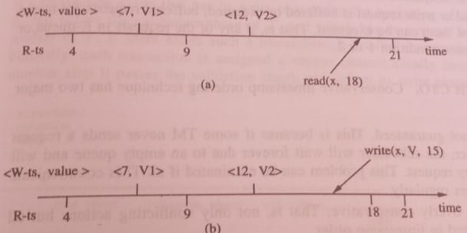
Multiversion Timestamp Ordering Algorithm
Reduces no: of aborts in BTO and TWR algorithms.
But requires huge data storage as a set of R-t’s and multiple version of Data objects are kept

